Slide 1
2020 Statistics Clinic
Boys Lacrosse in New York Section V

Slide 2
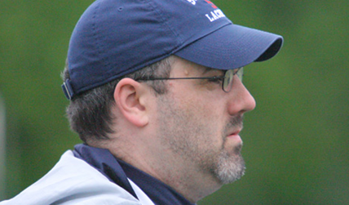
Kyle Barrett and Paul Wilson

Slide 3
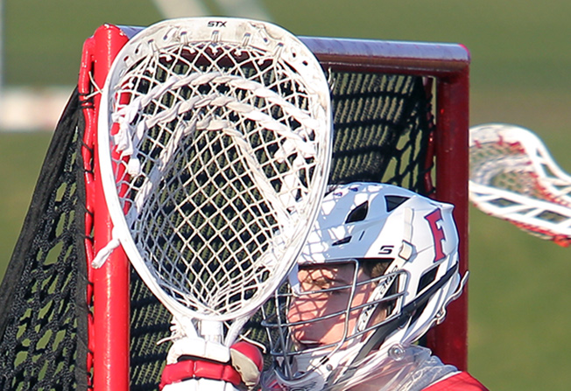

Slide 4
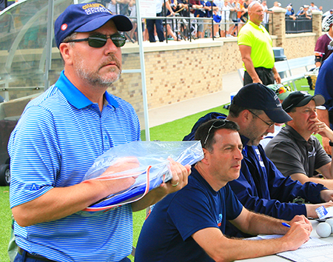
Agenda
Ethics
NCAA Stats Manual
Definitions
Forms / Reporting

Slide 5
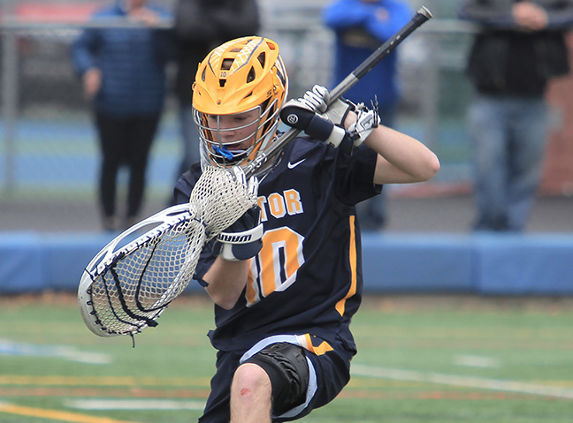

Slide 6
“There are three kinds of lies: Lies, Damned Lies and Statistics.”
Ethics
Mark Twain
We have an ethical duty to record the accurate history of what took place.

Slide 7
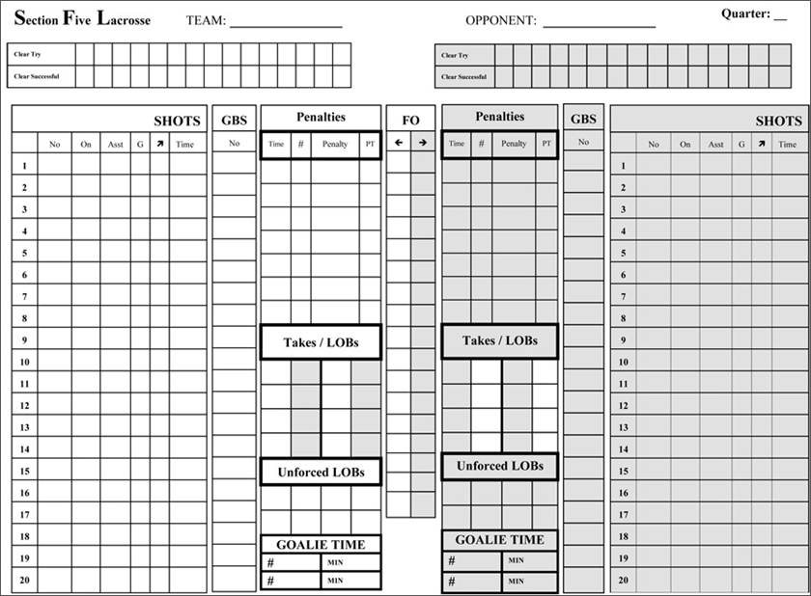
We have an ethical duty to record the accurate history of what took place
Ethics
1 – Be Professional
2 – Focus on the Play
3 – Ask For Help
4 – No “Padding Stats”

Slide 8
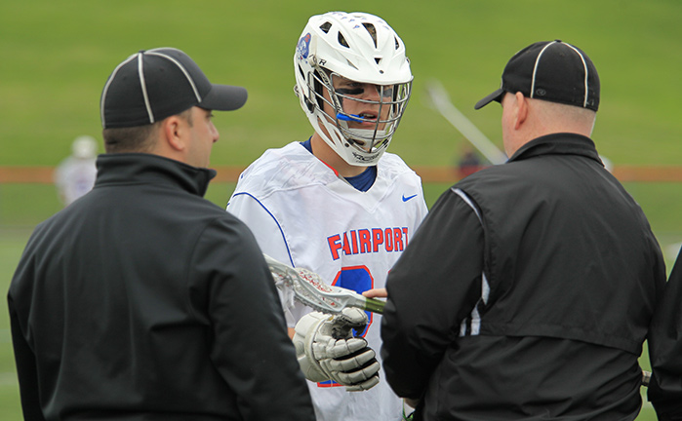

Slide 9
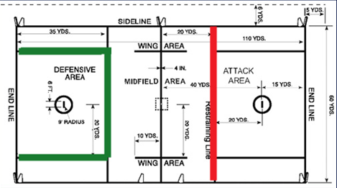
NCAA
CLEARS
Manual
NEW DEFINITION 2020:
“Philosophy. In an effort to combine the way the rules of clearing are now written with the historical intent of making clears reflect a team’s ability to transition from a settled defensive possession to an offensive possession, the definition of a successful clear will be changing radically for the 2020 season.

Slide 10
NCAA
CLEARS
Manual
As a basic rule of thumb, … a decision on successful vs. unsuccessful clears should be made on whether, in the best judgement of the official scorer, a team crossed midfield and legitimately had an opportunity to begin running its offense.”

Slide 11
NCAA
CLEARS
Manual
Successful clears are now defined as beginning any time a team takes possession of the ball (or enters into the area) behind the restraining line.
Successful clears end when the team crosses the midfield line and meet one of three conditions:

Slide 12
NCAA
CLEARS
Manual
1 – The Player takes a shot
2 – The Player makes a pass
3 – The Player had the ability to meet criteria 1 or 2 put chooses not to “of his own accord”

Slide 13
NCAA
CLEARS
Manual
“A.R.1– Team A is on defense. Team A forces a turnover and gains possession below its restraining line. Player 1 then throws a pass to Player 2, who catches the ball and then runs across the midline. Before Player 2 can shoot or pass, he turns over the ball.

Slide 14
NCAA
CLEARS
Manual
“A.R.2– Team A is on defense. Team A forces a turnover and gains possession below its restraining line. Player 1 then throws a pass to Player 2, who catches the ball and then runs across the midline. Player 2 then passes the ball to Player 3.

Slide 15
NCAA
CLEARS
Manual
“A.R.3. After Team A gains possession of the ball (behind the restraining line) and Player A is the first person to possess the ball across the midfield line. Player A is closely guarded by the defense and is unable to find a teammate to pass to or get a shot off before turning over the ball.”

Slide 16
NCAA
CLEARS
Manual
“A.R.7. Team A takes possession of the ball above the restraining line on its defensive side and brings the ball below the restraining line.

Slide 17
NCAA
CLEARS
Manual
“A.R.11. Defenseman A1 gains possession of the ball behind the restraining line, but not in the box. Team A clears the ball without ever going into the box.”

Slide 18
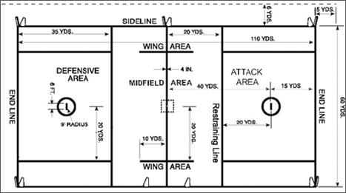
Question
The goalie makes a save and begins to clear the ball. He passes it to a midfielder who crosses the midline. Is this a successful clear?

Slide 19
Question
Team A starts a clear but the ball is knocked out of their stick. A midfielder on Team A picks the loose ball and runs it over the midfield line (and pass/shot). Is this a successful clear?

Slide 20
Question
A defenseman knocks down a pass which deflects outside the front of the goal area. He picks it up and runs to his offensive goal area. Is this a successful clear?

Slide 21
Question
A defenseman knocks down a pass which deflects outside the right of the goal area. He picks it up and runs into the defensive area. Is this the start of a clear?

Slide 22
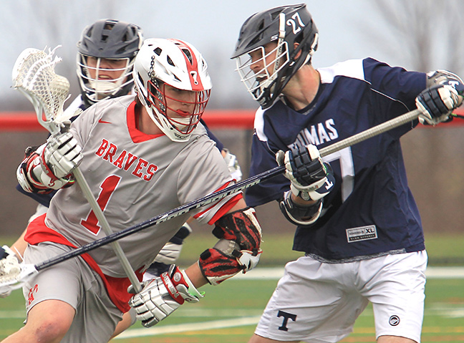

Slide 23
NCAA
SHOTS
Manual
“A ball propelled toward the goal by an offensive player shall be called a shot. The ball may be thrown from a stick, kicked, or otherwise physically directed to be credited as a shot.”

Slide 24
NCAA
SHOTS
Manual
“The statistician should take care to award shots only when possession of the ball can reasonably be said to have occurred or by ricochet or when a controlled effort can be construed somewhat similar to controlled tips in basketball).”

Slide 25
NCAA
SHOTS
Manual
“Article 2. A ball that enters the goal propelled by the offensive team must then become a shot and a goal.
Article 3. A ball that ricochets off another player and enters the goal will be credited as a shot by the player deemed to have scored the goal…”

Slide 26
NCAA
SHOTS
Manual
“Article 4. In the case of a team goal (also known as an own goal), there is no shot recorded.
[See Goals for more definitions.]

Slide 27
NCAA
SHOTS
Manual
“NOTE: One of the most common mis-definition in lacrosse is that of “shot on goal.” A shot on goal is not the same thing as a shot at the goal. The latter encompasses all shots; the former encompasses only shots scoring and those having been saved by the goalie. A shot that hits the pipe is not a shot on goal.”

Slide 28
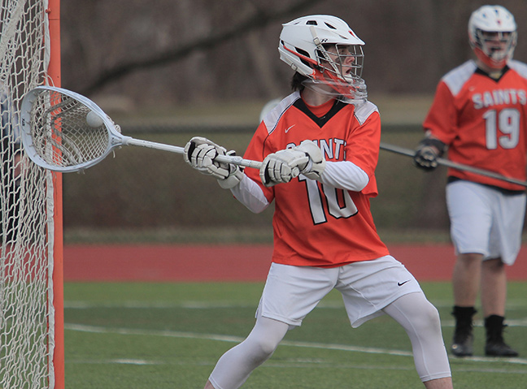

Slide 29
NCAA
GOALS
Manual
“Article 1. A goal should be credited to the player who shot the ball, scoring a goal for his own team. In certain situations, a team goal (also known as “own goal”) may be credited. However, statisticians should err on the side of awarding the goal to the player who took the original shot.”

Slide 30
NCAA
GOALS
Manual
“(1) A shot that strikes another offensive player and deflects into the goal should be credited as a goal to the player who last touched the ball before it entered the goal. The player credited with the goal must also be credited with a shot; the original shooter should be credited only with a shot, not an assist.”

Slide 31
NCAA
GOALS
Manual
“(2) A ball entering the goal that appeared to have been a pass to another player shall be counted as a shot and a goal for the player who made the pass.”

Slide 32
NCAA
GOALS
Manual
“(3) A team goal will be credited if a defensive player gains possession of the ball and then causes the ball to enter his own team’s goal.”

Slide 33
Question
A player takes a shot which bounces off a defenseman and scores. Who gets credit for the goal/assist?

Slide 34
Question
A player takes a shot which bounces off a teammate and scores. Who gets credit for the goal/assist?

Slide 35
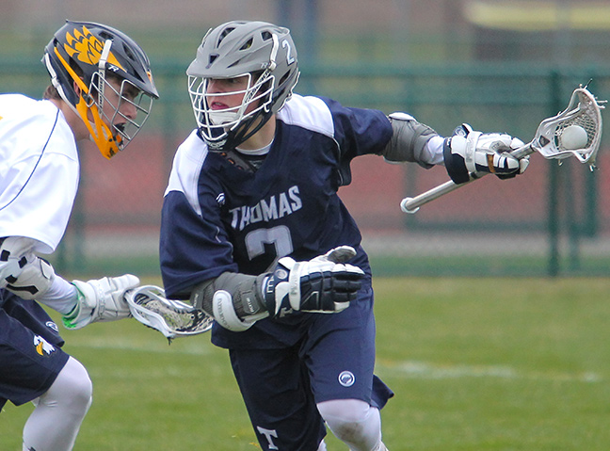

Slide 36
NCAA
ASSISTS
Manual
“Philosophy. An assist is not necessarily credited to a player who makes a pass before a goal. There should be conscious effort on the part of the passer to find an open player for a shot or to help a player work free for a shot.”

Slide 37
NCAA
ASSISTS
Manual
“There should be no particular time frame for an assist (although the pass and shot should appear to be part of the same play) nor should there be any rigid distance factor in the play (the player scoring the goal could take one step, several steps, or even run a number of yards with the ball and still have the passer credited with an assist).”

Slide 38
NCAA
ASSISTS
Manual
“An assist should not be credited on a play when the goal scorer dodges a defensive player after receiving the pass before shooting unless, in the opinion of the statistician, it was the pass itself and not the dodge that led directly to the shot.”

Slide 39
NCAA
ASSISTS
Manual
“Article 1. A player is credited with an assist when he makes, in the opinion of the statistician, a pass contributing directly to a goal. An assist cannot be credited to any player other than the one who had the ball immediately before the player credited with the goal.”

Slide 40
NCAA
ASSISTS
Manual
“Article 2. A goal that is scored when the ball deflects off of an offensive player into the goal can have an assist if, in the scorer’s opinion, the player whose action caused the ball to deflect off of the second player was attempting to pass and not shoot.”

Slide 41
Question
After three steps (or two seconds) there cannot be an assist on the play. True or False?

Slide 42
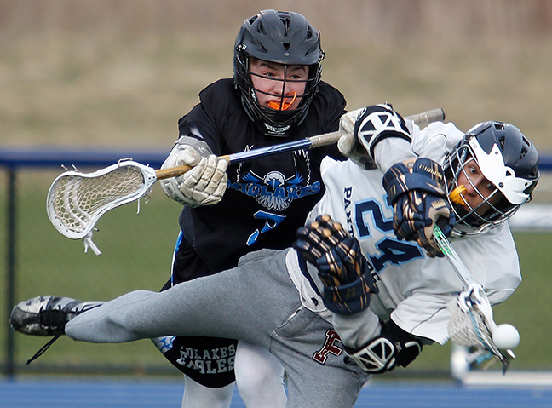

Slide 43
NCAA
SAVES
Manual
“Philosophy. The basic rule of a save is that any time a ball is stopped or deflected with any part of the goalie’s body or stick, which if not stopped or deflected would have resulted in the ball entering the goal, a save is recorded.”

Slide 44
NCAA
SAVES
Manual
“The statistician should focus on what would have happened to the ball if it had not been stopped or deflected by the goalie. If the shot would have scored, then award the goalie a save. If it would not have scored, do not credit a save. The tendency is to give a goalie a save every time he touches a shot; this creates inflated statistics.”

Slide 45
NCAA
SAVES
Manual
“No matter how difficult it is to determine, the statistician should make consistent judgments on each shot that goalies stop or deflect.
Consistency must be maintained so that the national statistics are meaningful.”

Slide 46
NCAA
SAVES
Manual
“Article 1. Offensive efforts that the goalie prevents from going into the goal are considered saves. A team save can be credited in certain situations see approved rulings below). If the goalie is in the crease, no one else can be credited with a save (including a team save).”

Slide 47
NCAA
SAVES
Manual
“Article 2. A blocked shot by a defenseman is not considered a save unless the defenseman is in the crease and the goalie is not.”
In NYS defensemen cannot enter the crease to act as a goalie.

Slide 48
NCAA
SAVES
Manual
“Article 3. A shot that hits the pipe, rebounds off the goalie’s body and would go into the goal if not stopped by the goalie is credited as a save. A shot that hits the pipe, rebounds off the goalie’s body and would not go into the goal before being picked up by another player is credited as a ground ball.”

Slide 49
Question
The goalie catches a shot outside the goal posts. Is this a save?

Slide 50
Question
A shot is taken and the goalie stops the ball from rolling into the goal. Is this a save?

Slide 51
Question
The goalie stops a shot and takes control of the ball. He then drops the ball into the goal. Who get credit for the goal?

Slide 52
Question
The goalie stops a shot but before he gains full control, it dribbles into the goal. Who get credit for the goal?

Slide 53
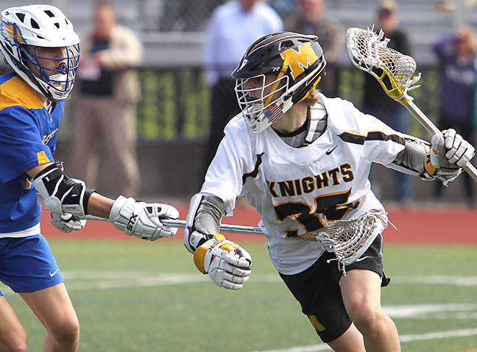

Slide 54
NCAA
GROUND BALLS
Manual
“Philosophy. Any ball not in possession of either team that comes into possession of either team should result in a ground ball once a player establishes possession and is immediately able to perform the normal functions of possession (i.e., shoot, pass, cradle), provided the ball was contested by both teams before establishing possession.”

Slide 55
NCAA
GROUND BALLS
Manual
“Article 1. The statistician will determine whether or not the ball is being contested, keeping in mind that contested could refer to the original player with possession, the player gaining possession or the ball itself.”

Slide 56
NCAA
GROUND BALLS
Manual
“Article 2. If a player is in possession of the ball, drops it while uncontested, and then regains possession, he cannot be credited with a ground ball even if he is contested while regaining possession. If that player has the ball checked out of his stick and then regains possession, he may be credited with a ground ball.”

Slide 57
NCAA
GROUND BALLS
Manual
“Article 3. Ground balls can be credited as part of the faceoff play. In a faceoff situation, a ground ball should be credited to the player who gains clear possession regardless of whether or not the player gaining possession is being contested at that time.”

Slide 58
NCAA
GROUND BALLS
Manual
“Article 4. A ground ball should be credited to an offensive or defensive player who gains possession of the ball and prevents it from either going out of bounds or reaching the midline even if the play was not being contested. The philosophy is to give statistical credit for gaining or maintaining possession.”

Slide 59
NCAA
GROUND BALLS
Manual
“Article 5. A loose ball that is not contested and would not reach the midline or go out of bounds should not result in a ground ball.”

Slide 60
Question
A ball is passed but falls on the ground and a player on the same team picks up the ball without a challenge. Is this a ground ball?

Slide 61
Question
A ball is about the roll out of bounds but a player stops it and picks it up. There is no challenge for the ball. Is this a ground ball?

Slide 62
Question
A ball is shot past the end line. The closest player to the ball when it goes out gets a ground ball stat. Is this True or False?

Slide 63
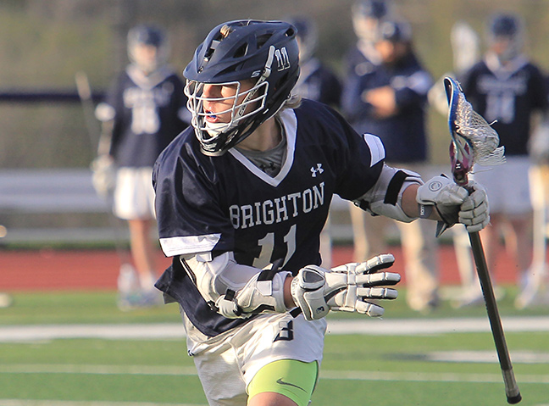

Slide 64
NCAA
TAKES LOBs
Manual
“Article 1. Turnovers occur when a player or team in possession of the ball or entitled to possession of the ball loses possession of it, in a live-ball situation or under certain dead-ball situations.”

Slide 65
NCAA
TAKES LOBs
Manual
“If a single player is judged to be primarily responsible for the turnover, that player is charged with the turnover. If no single player can be judged to be primarily responsible for the turnover, or if the responsibility rests with anyone not a player, then the team is charged with the turnover.”

Slide 66
NCAA
TAKES LOBs
Manual
“Article 2. A caused turnover is credited to a player when the player’s positive, aggressive action(s) causes a turnover by the opponent. A turnover may not always warrant a caused turnover; however, caused turnovers can only be awarded to an individual player, and only one caused turnover can be awarded for a turnover.”

Slide 67
NCAA
TAKES LOBs
Manual
“There cannot be more caused turnovers than turnovers. Any turnover charged as a team turnover cannot have a corresponding caused turnover.”

Slide 68
NCAA
TAKES LOBs
Manual
“Article 3. For a change of possession that occurs that cannot be attributed to a particular player at the moment of the violation, the turnover should be charged as a team turnover.”

Slide 69
NCAA
TAKES LOBs
Manual
“Article 4. A missed shot cannot be a turnover.
Article 5. All failed clears are by definition also turnovers.”

Slide 70
NCAA
TAKES LOBs
Manual
“Article 6. A team is in possession of the ball and is called for any “failure to advance” penalty other than the failure of the goalie to leave the crease within four seconds. This should be credited as a team turnover, unless in the statistician’s opinion, one player was principally responsible…”

Slide 71
Question
When there is a “Take” there must also be a “Loss of Ball”. Is this True or False?

Slide 72
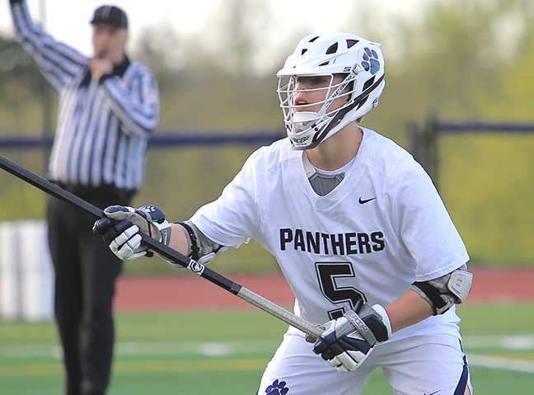

Slide 73
NCAA
Face offs
Manual
“Philosophy. Since many faceoff men must depend on the statistics of faceoffs to provide an evaluation of their value, statisticians must be consistent in their assessment of faceoffs. Since the standard in faceoff stats is to award to the faceoff man the faceoff, whether he actually obtained possession or not…”

Slide 74
NCAA
Face offs
Manual
“Additionally, ground balls should be credited in faceoff play (there can be more than one) as indicated in Section 5. Every faceoff has to end with players being credited and charged with a faceoff win and loss, unless the quarter ends before possession is established.”

Slide 75
NCAA
Face offs
Manual
“Article 1. A faceoff win is determined by clear possession of the ball, not by the subsequent offensive opportunity.”

Slide 76
NCAA
Face offs
Manual
“A standard [false] alternative to that definition is to credit and charge the faceoff when one team is declared to have possession of the ball, and wing area players are released. This is not really a viable definition since a team may never have a chance to do anything with the ball.”

Slide 77
NCAA
Face offs
Manual
“Article 2. Credit the faceoff to the team that gains clear possession of the ball and can perform the normal functions of the possession, not based on the possession that is called by the referee………”

Slide 78
NCAA
Face offs
Manual
“The referee’s signal of possession has no influence on the statistical determination of faceoff wins and losses. The referee’s signal frequently precedes the statistical definition of possession”

Slide 79
Question
A face off must have a ground ball. Is this True or False?

Slide 80
Question
A face off must have a winner. Is this True or False?

Slide 81
Question
The game is in running time and a penalty is called. When does the penalty time start?

Slide 82
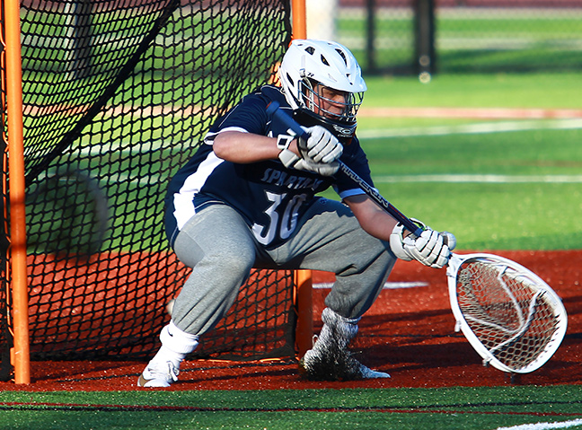

Slide 83
1st - When the Game Ends:
Reporting
Game Information
Report the Final Score & the Quarter Scores
Send an email to: scores@sportsfive.net
Or Send a text to: 585-348-7316 Or leave message: 585-348-7316

Slide 84
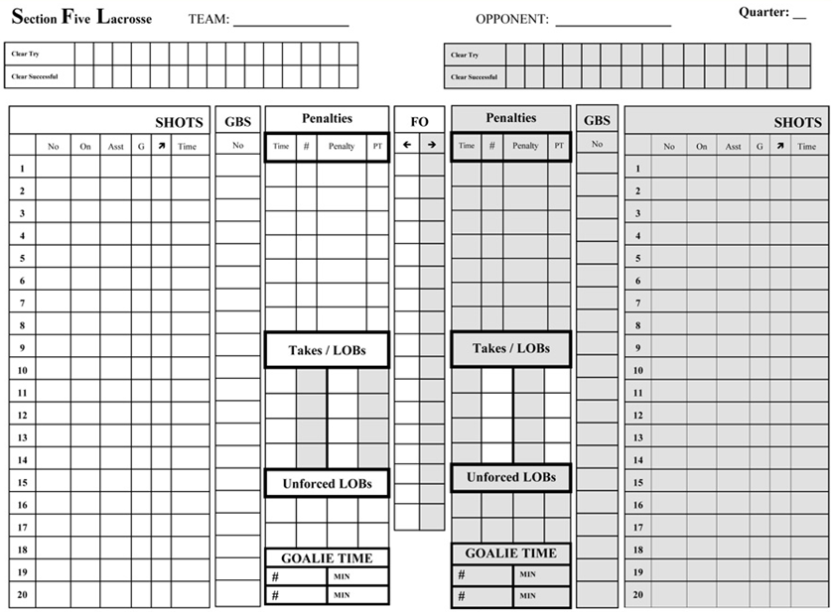
Data
Collection
“WHITE” Team Data
“GREY” Team Data
Game Form
Use one sheet per quarter

Slide 85
Data
Collection
Use one sheet per quarter

Slide 86
Data
Collection
Clears
Use one sheet per quarter

Slide 87
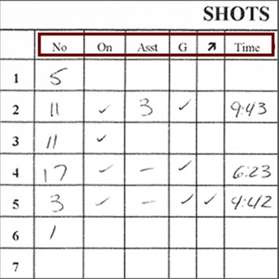
Data
Collection
SHOTS
No – Jersey #
On – Shot on goal
Asst – Assisted #
G – Goal scored
-> - Man up/Down
Time – of goal
Use one sheet per quarter

Slide 88
Data
Collection
Ground Balls
Circle ground balls won during face offs.
Use one sheet per quarter

Slide 89
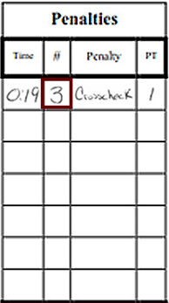
Data
Collection
Penalties
Circle the number if EMO scores
Square means don’t count as an attempt.
Use one sheet per quarter

Slide 90
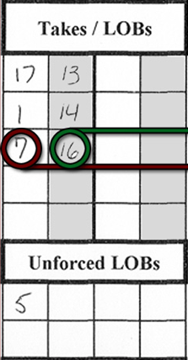
Data
Collection
Takes/LOBs
#16 lost the ball
#7 took the ball
Use one sheet per quarter

Slide 91
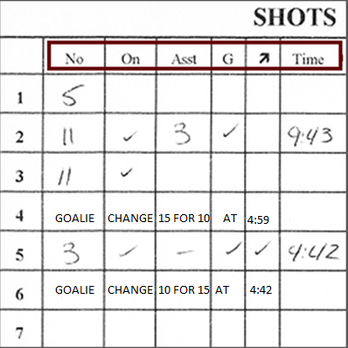
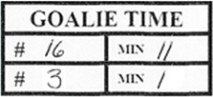
Data
Collection
Goalie Time
The number of minutes played by each goalie.
Use one sheet per quarter

Slide 92
Data
Collection
Face Offs
Enter each FO man and circle the winner.
If won by Tech write “T” or put a square around the winner
Use one sheet per quarter

Slide 93
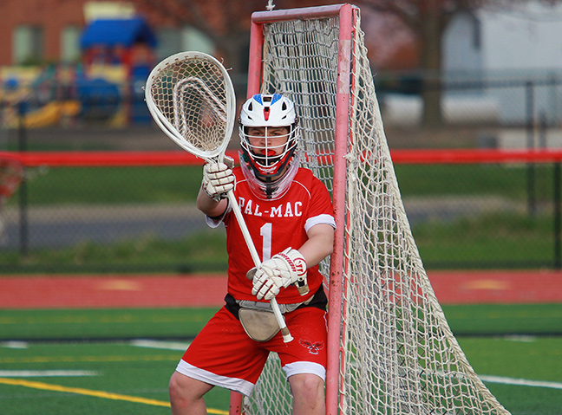

Slide 94
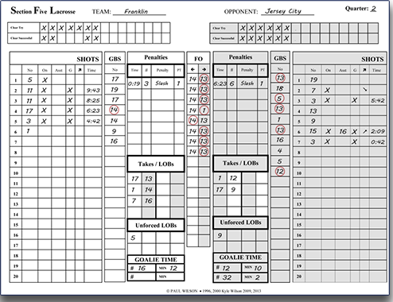
Data
Collection
Start with information.

Slide 95
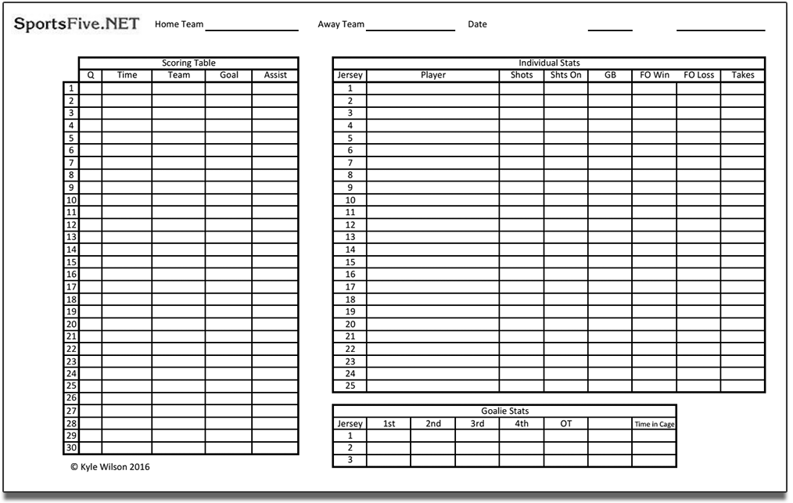
Data
Collection
Tally data.

Slide 96
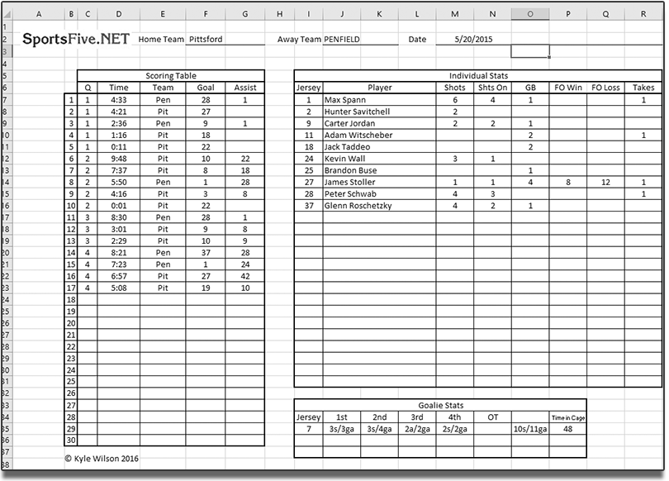
Data
Collection
Summary Sheets

Slide 97
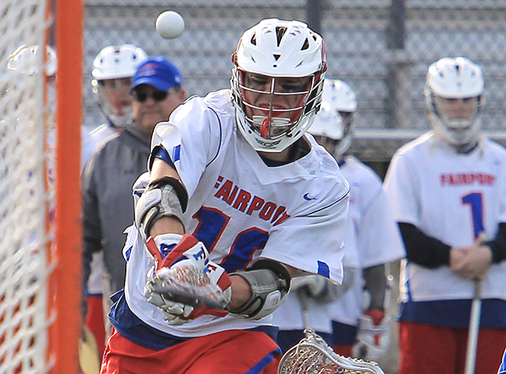

Slide 98
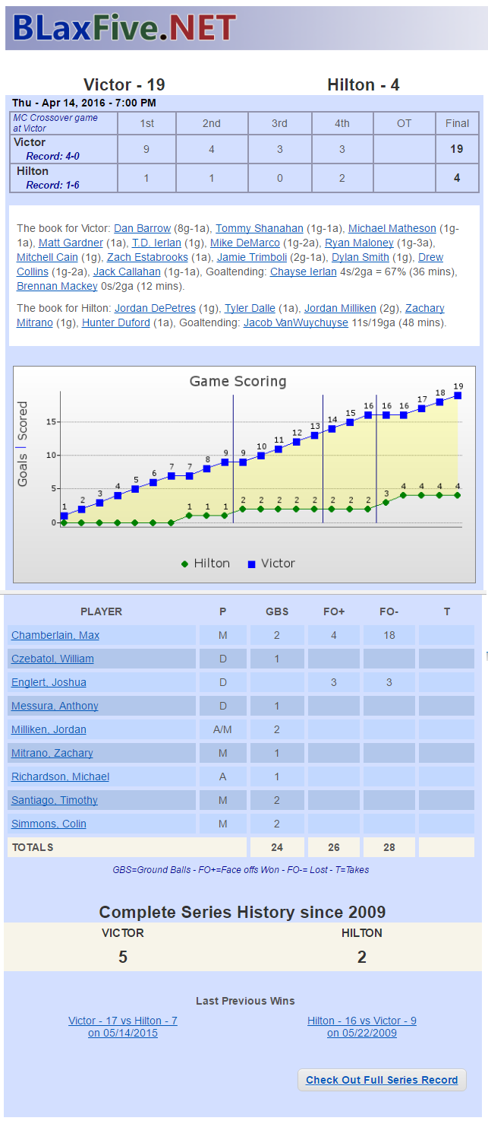
Reporting
As information arrives it shows up
Score
Quarter Scores
Scoring Table Graph
Series History
Player Data

Slide 99
2nd - Later that SAME DAY
Reporting
Game Information
Send in Game Information
Prepare the stats – gather story information
Email them to: scores@sportsfive.net

Slide 100
3rd – The Next DAY
Reporting
Game Information
Check the Game Story and Stats
Read the story on BLaxFive.NET
Send corrections is needed to:
Email: wilson@sportsfive.net

Slide 101
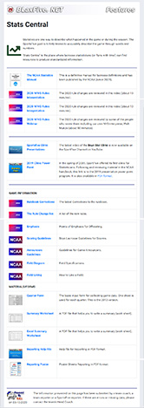
“Stats Central” Page
Stats Manual
Input Forms
Field Diagrams
And More. . .
http://blaxfive.net/features/stats_central.php

Slide 102
2020 Statistics Clinic
Boys Lacrosse in New York Section V
Thanks for all you do.

